Slide 1
EasyWay - conclusion

Slide 2
Key factors
A project for Europe-wide ITS deployment on main TERN corridors
It sets clear targets, identifies the set of necessary ITS European services to deploy (Traveller Information, Traffic Management and Freight and Logistic Services).
Driven by national road authorities and operators with associated partners including the automotive industry, telecom operators and public transport stakeholders.

Slide 3
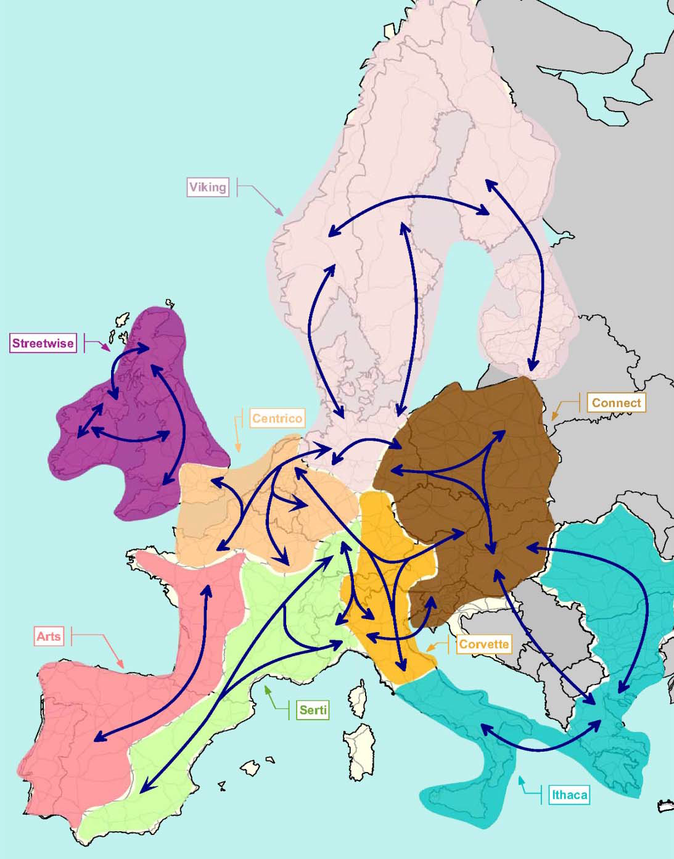
Real deployments in corridors
Harmonization + standardization
Advisory function
Guidelines for services
…

Slide 4
An integrated project for Europe-wide ITS deployment on the TERN
3 European objectives :
Increase road safety,
Increase mobility and decrease congestion,
decrease transport burden on the environment
One mean : deploy European harmonized ITS services
95% of the budget is allocated to deployments
A set of 6 European studies set the frame for harmonized deployments
EasyWay implements most part of the ITS action plan

Slide 5
Core issues
Traveller Information,
Traffic Management,
Freight and Logistic Services,
Connected ICT Infrastructure and
Crosscutting issues
Harmonisation, (VMS, DATEX, roadmap)

Slide 6
EW Deployments … (example from 2008)
Traveller Information Services
More than 50 millions of European citizens targeted through 􀂃 More than 23 000 km of the TERN improved with ontrip
traveller information and warnings …
Traffic Management Services
urban areas: 450 km of Dynamic lane management, 95 new Ramp metering systems, 5300 Incident warning, 2000 km of Incident management, 1400 km of Speed control …)
Freight & Logistics Services
966 km of TERN network covered by special information services for freight, 72 parking stops with dynamic or static information on truck parking services …

Slide 7
EW Deployments … (example from 2008)
Connected ICT Infrastructure
Increased monitoring infrastructure by ca. 1,800 fixed traffic monitoring stations, 6,300 km travel time monitoring coverage, 1,000 km automatic incident detection, 68 critical spots covered with automatic incident detection, 5,700 CCTV cameras, 540 road weather monitoring stations
New or upgraded centers to operate European ITS services
350 traffic information/control/management centres, 33 DATEX nodes

Slide 8
EW Guidelines – key points
A definition of the Core Services;
A set of functional and organisational requirements and recommendations (for implementation);
A set of technical requirements and recommendations (for interoperability of Core Service implementations);
A set of requirements and recommendations that enable a common “look & feel” (display of info);
A recommended level of service (a minimum and an optimum) based on Operating Environment.

Slide 9
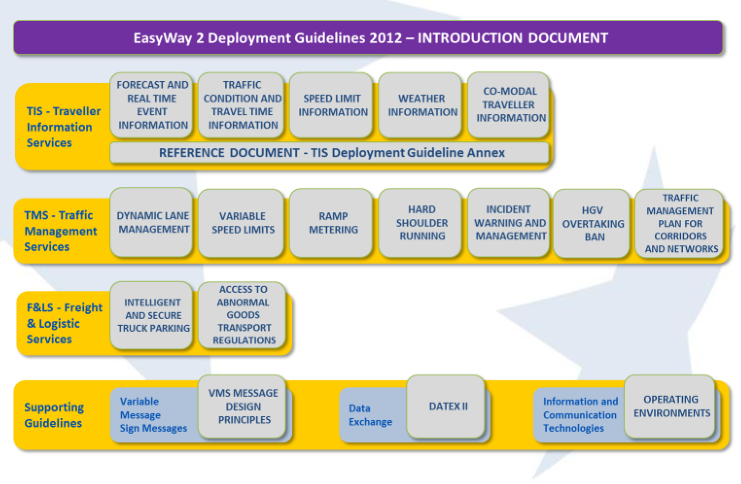

Slide 11
Remaining Guidelines
Ramp Metering
HGV Overtaking Ban
Traffic Management Plan Service for Corridors and Networks
Access to Abnormal Goods Transport Regulations
Principles of VMS Design
DATEX II
EasyWay Operating Environments

Slide 12
Ramp Metering
Ramp metering is a traffic management measure designed to reduce the disruption from platoons of vehicles entering the main carriageway at on-ramps.
is characterised by:
mainline and ramp traffic monitoring
regulation of the flow of traffic entering the main carriageway via traffic signals positioned on the on ramp
the use of algorithms to determine the required flow and thus the signal timings

Slide 13
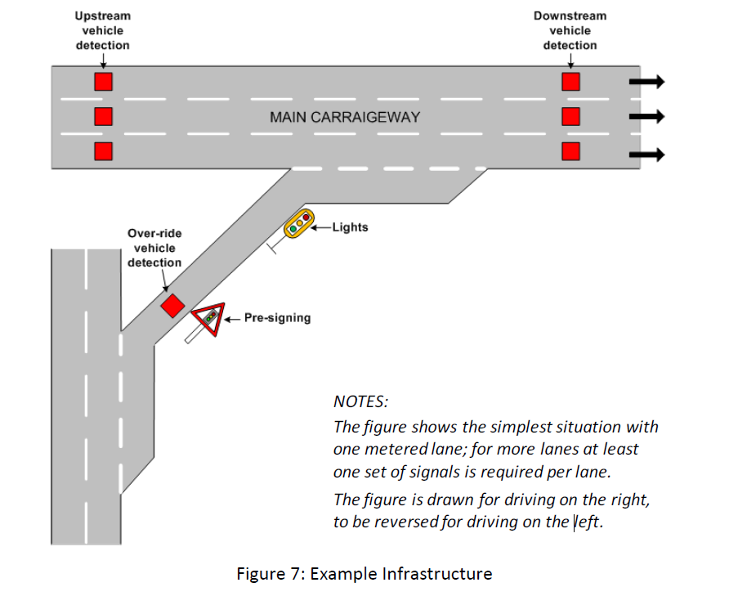

Slide 14
HGV Overtaking Ban
The deployed HGV overtaking ban intends to:
Monitor and manage the HGV traffic flow onto the motorway network,
Improve journey duration and safety for personal vehicles by reducing queues caused by slow lorries overtaking,
Ensure a better acceptance of heavy goods vehicles by other road users
Information provision (Pre-trip and on-trip), VMS, should be coordinated with traffic management plans.
In practice, an HGV overtaking ban is often an integrated part in a larger traffic management system:
Hard shoulder running
Dynamic lane management
Variable speed limit
Dynamic incident warning

Slide 15
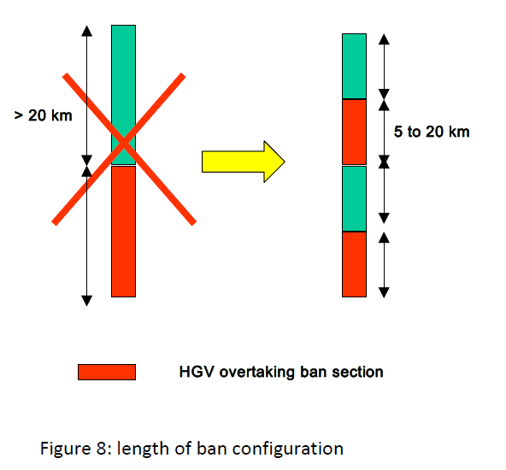
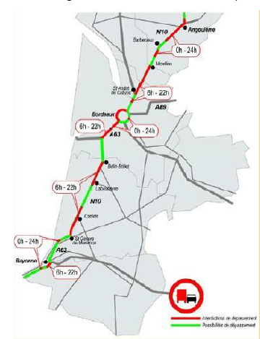

Slide 16
Traffic Management Plan Service for Corridors and Networks
A TMP is the pre-defined allocation of a set of measures to a specific situation in order to control and guide traffic flows as well as to inform road-users in real-time and provide a consistent and timely service to the road user.
Initial situations can be unforeseeable (incidents, accidents) or predictable (recurrent or non-recurrent events). The measures are always applied on a temporary basis.

Slide 17
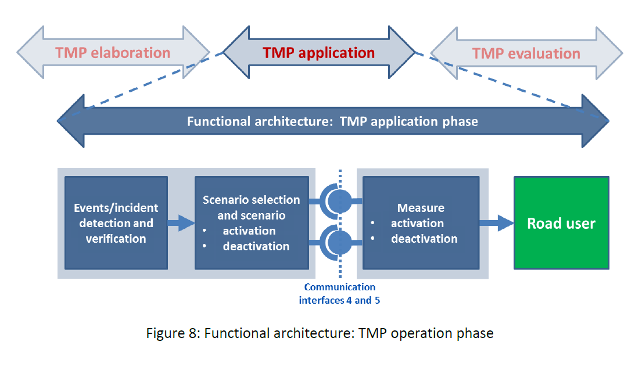

Slide 18
Access to Abnormal Goods Transport Regulations
information service for country-specific information on the vehicle regulations and permit application procedures, contact persons, and guidelines for completing application forms for abnormal transports.
provides access to the necessary information
abnormal transports standardised for all European States, in a language understandable to the haulier/applicant and in a time frame acceptable to modern logistics.

Slide 19
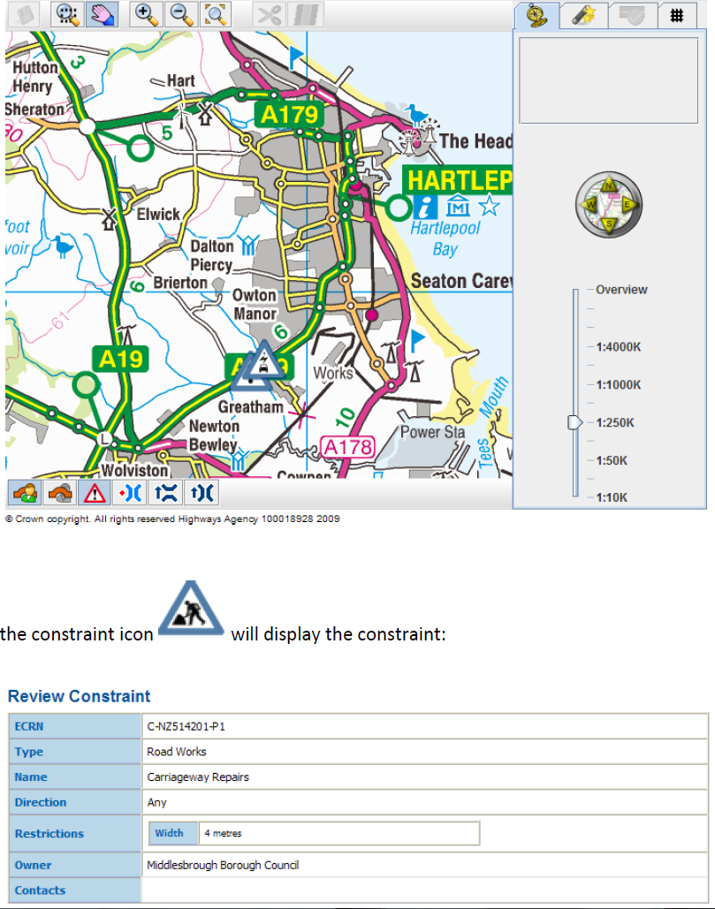
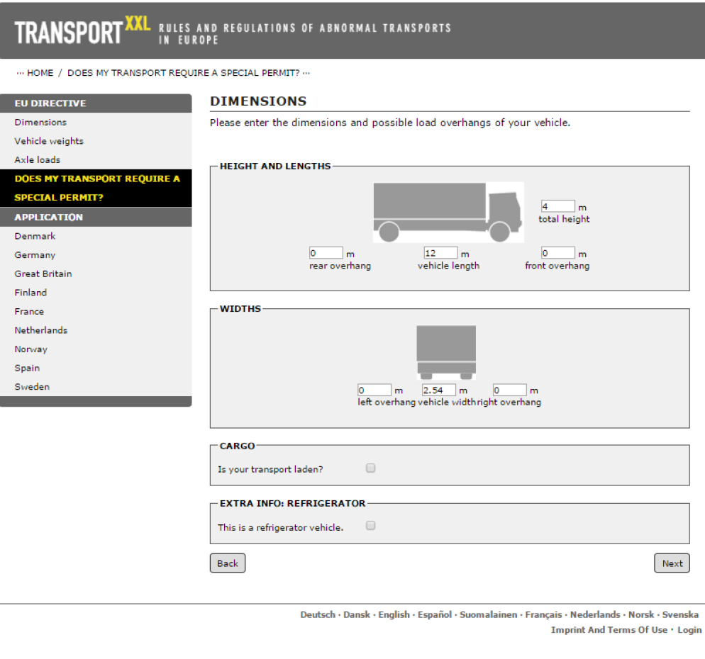

Slide 20
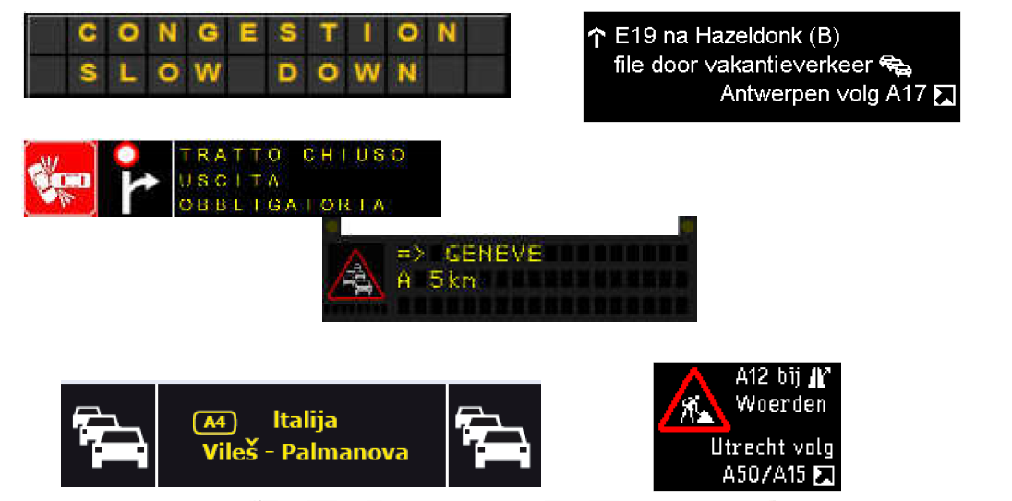
Principles of VMS Design
the general philosophy of VMS message design, synthesized through its 32 principles.

Slide 21
DATEX II
A standardised way to exchange data,
data is:
Road and traffic-related events (called in DATEX II “Traffic elements”)
Operator actions (like network management, road works, sign setting)
Parking information
Non-road event information including multimodal information
Elaborated data (derived/computed data, e.g. travel times, traffic status)
Measured data (direct measurement data from equipment or outstations, e.g. traffic and current weather measurements)
Messages displayed on Variable Message Signs (VMS).

Slide 22
EasyWay Operating Environments
a set of 18 pre-defined Operating Environments where each is a combination of three criteria:
Physical characteristics – Motorways, other 3/4 lane roads or 2-lane roads
Network typology – Corridor, Network, Link or Critical spot
Traffic characteristics – Traffic flow and road safety situations (with optional additions)

Slide 23
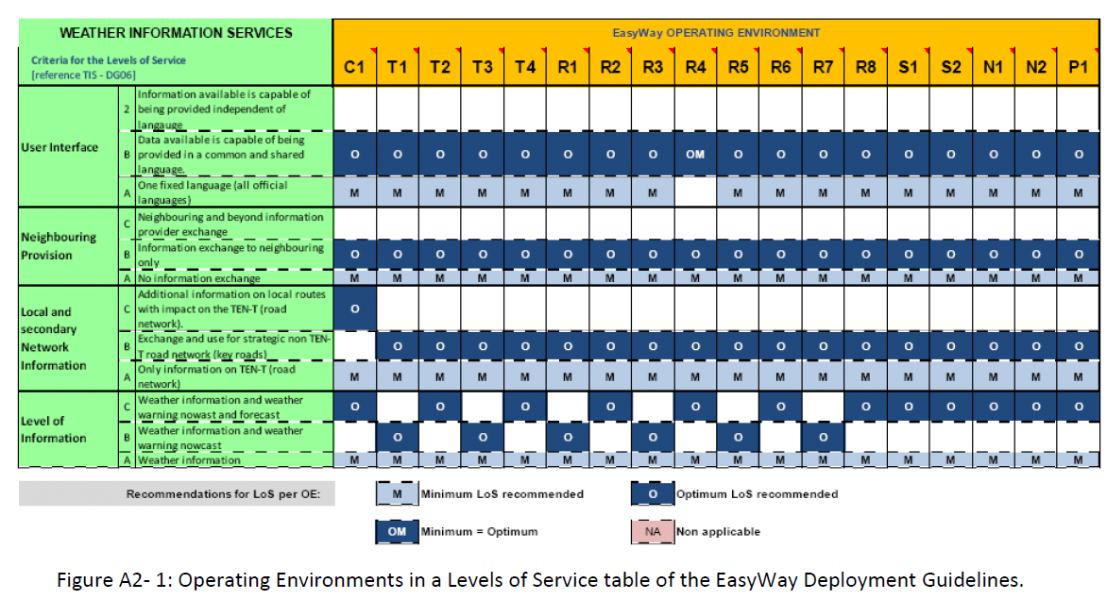

Slide 24
European Dimmension

Slide 25
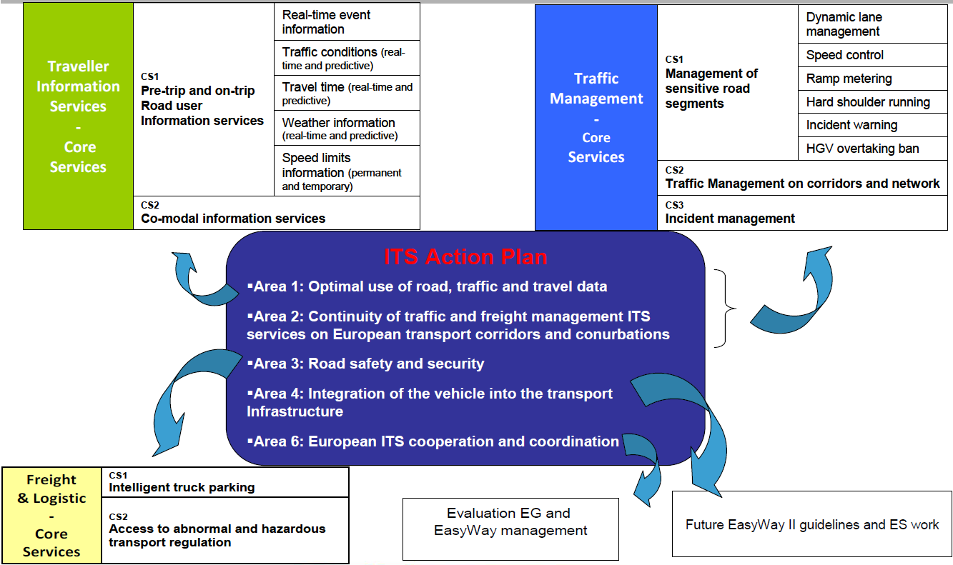
EW and ITS Action plan

Slide 26
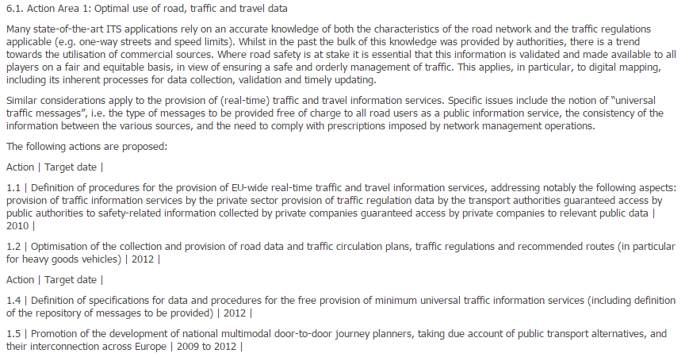
ITS Action plan – Action area
Priority area example

Slide 27
ITS Directive 2010/40/EU
Defines 6 Priority Actions „for the development and use of specifications and standards“:
the provision of EU-wide multimodal travel information services
The provision of EU-wide real-time traffic information services
Data and procedures for the provision, where possible, of road safety related minimum universal traffic information free of charge to users
The harmonised provision for an interoperable EU-wide eCall
The provision of information services for safe and secure parking places for trucks and commercial vehicles
The provision of reservation services for safe and secure parking places for trucks and commercial vehicles

Slide 28
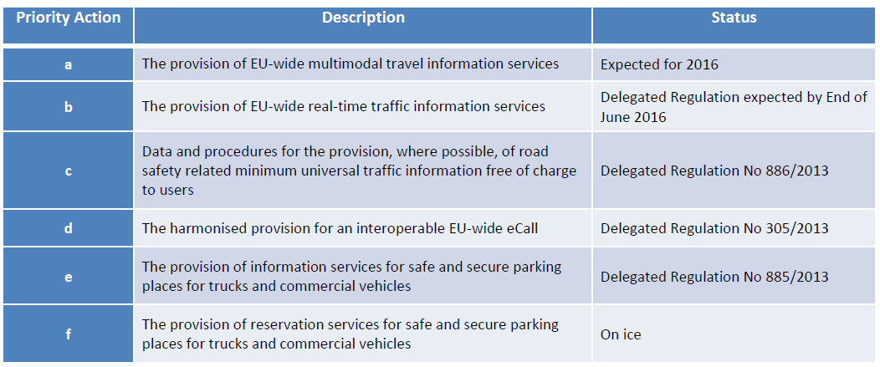
ITS Directive 2010/40/EU

Slide 29
Discussion?

